Slide 1
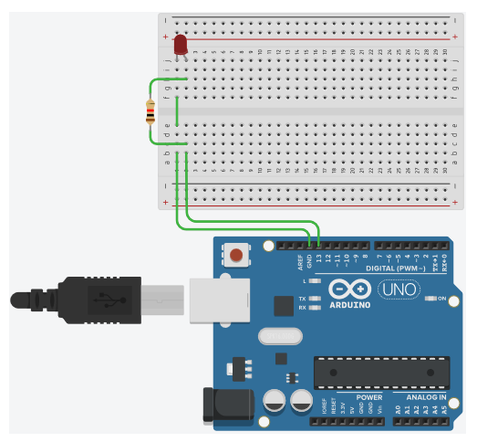
CS341 Lab 4
Memory Mapped I/O
https://github.com/whittyh/CS341

Slide 2
Lab 4 Objectives:
Repeat lab 1 without special functions like digitalWrite()
Determine which bits in memory control pin 13:
Use digitalWrite() to change pin 13’s pin mode
Use functions from previous labs (provided in starter code) to display memory addresses in relevant range
Identify what addresses are being changed by the digital write
Use Memory Mapping to directly access and change pins by changing certain bits
Use a bitshift and bitmask to read/write specific bits in memory
Use pointers to access the data in certain registers

Slide 3
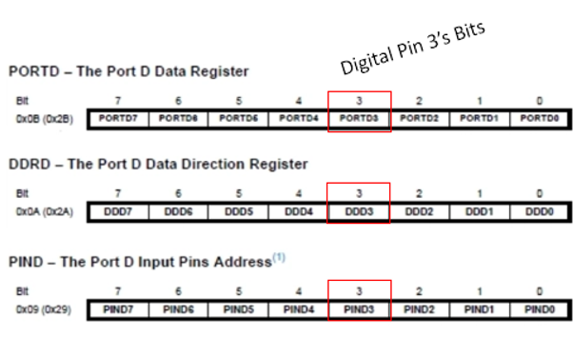
Understanding the pins:
Data Register: where we write to
Data Direction Register:
0 for reading, 1 for writing
Input Pins: where we read from
digital sensors read high/low, 0 or 1
Analog sensors signal is interpreted with an analog to digital converter (ADC) into 10 bits of binary, or a decimal number between 0-1023

Slide 4
Interfacing with a digital pin two ways:
functions: | Memory Addresses:
pinMode(int pin, OUTPUT); | Set data direction bit to 1
pinMode(int pin, INPUT); | Set data direction bit to 0
digitalWrite(int pin, HIGH); | Set data bit to 1
digitalWrite(int pin, LOW); | Set data bit to 0
digitalRead(int pin); | Check value of input bit

Slide 5
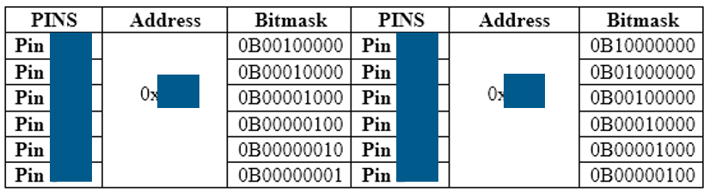
How to find out which register and bits:
displayRAM((char *) 0x020, (char *) 0x02f, true);
Same as lab 2, example output:
020: 00 00 00 00 20 00 00 00 00 01 00 00 00 00 00 00
displayBits(0x020);
Prints contents of address in binary, example output:
1001111

Slide 6


Blinking the LED manually example:
Pretend that the address for writing pin 7 is 0x50 and the correct bit for writing is the 6th bit 0100 0000₂
To set pin 7 high we would use a pointer and set the correct bit to 1 (in setup):
Then to flash pin 7 we can bitmask with xor (in loop):
And add a delay(1000);

Slide 7
A strategy for this lab:
Figure out which register values change when LED is on:
(in setup)
Set pinMode to write and write pin 13 high
Display relevant registers RAM with displayRAM();
Set pin 13 low
Display relevant registers in RAM
Observe which register values changed
Figure out which bit needs to be masked:
Add a call to displayBits() for the address(s) you think are relevant
Setup the loop like the example in slide 6 testing the bit and address you believe is correct.
NOTE: you might notice more than one register change. This is normal try to study slide 3 and determine what is be happening.

